Slide 1





PMT: Power Measurement Toolkit
Stefano Corda, Bram Veenboer, Emma Tolley
stefano.corda@epfl.ch

Slide 2
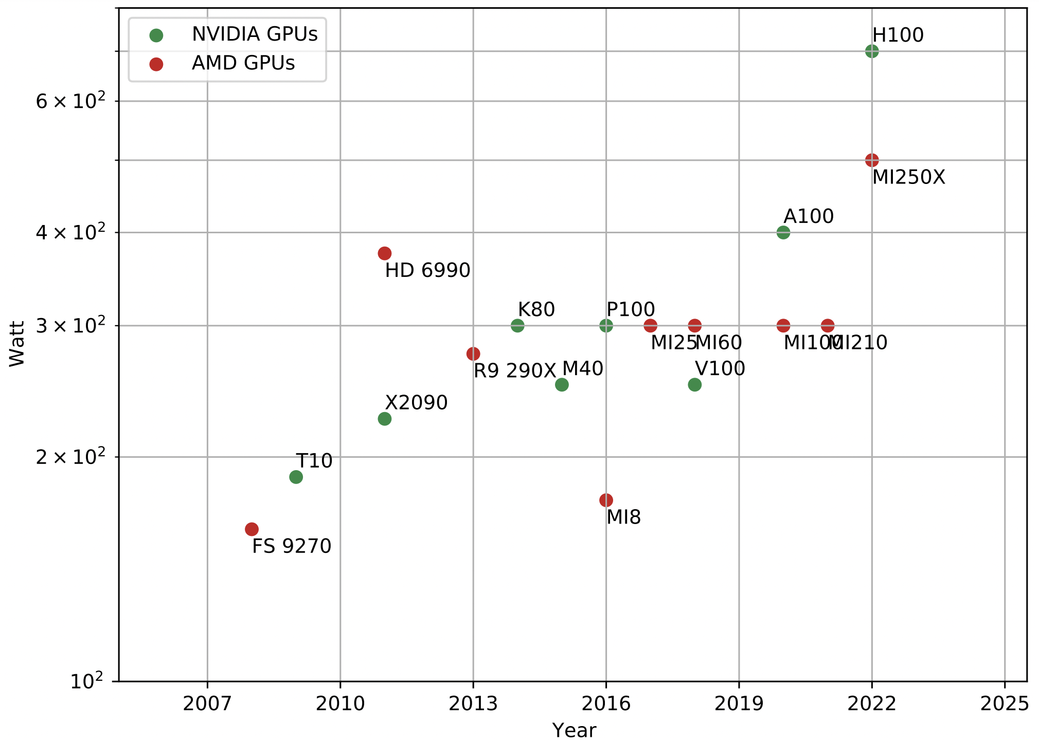
Why should we measure power consumption?
New supercomputers are power-hungry.
Certain use cases, e.g. SKA, have limited power budget.
Carbon footprint and energy savings for the environment.
Tools for power consumption monitoring are necessary → PMT (Power Measurement Toolkit).

Slide 3
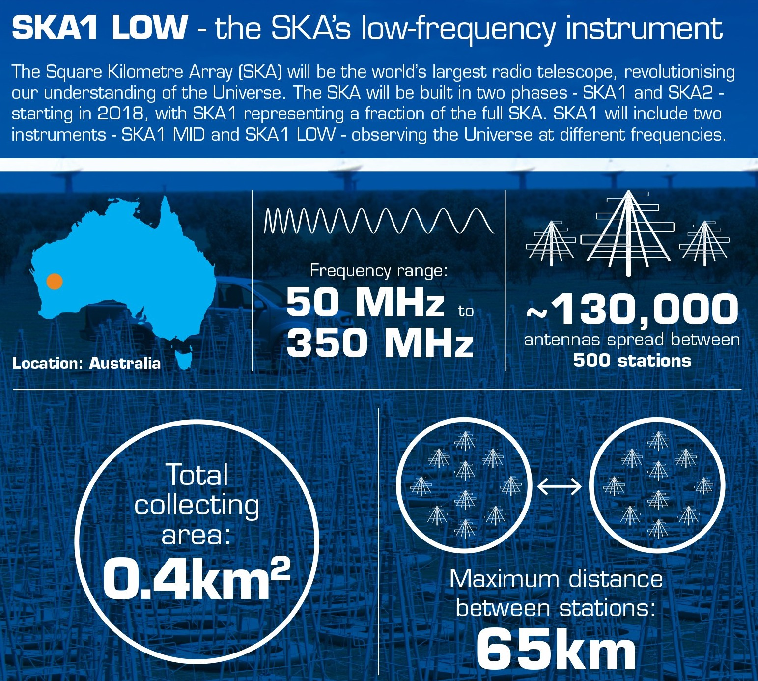
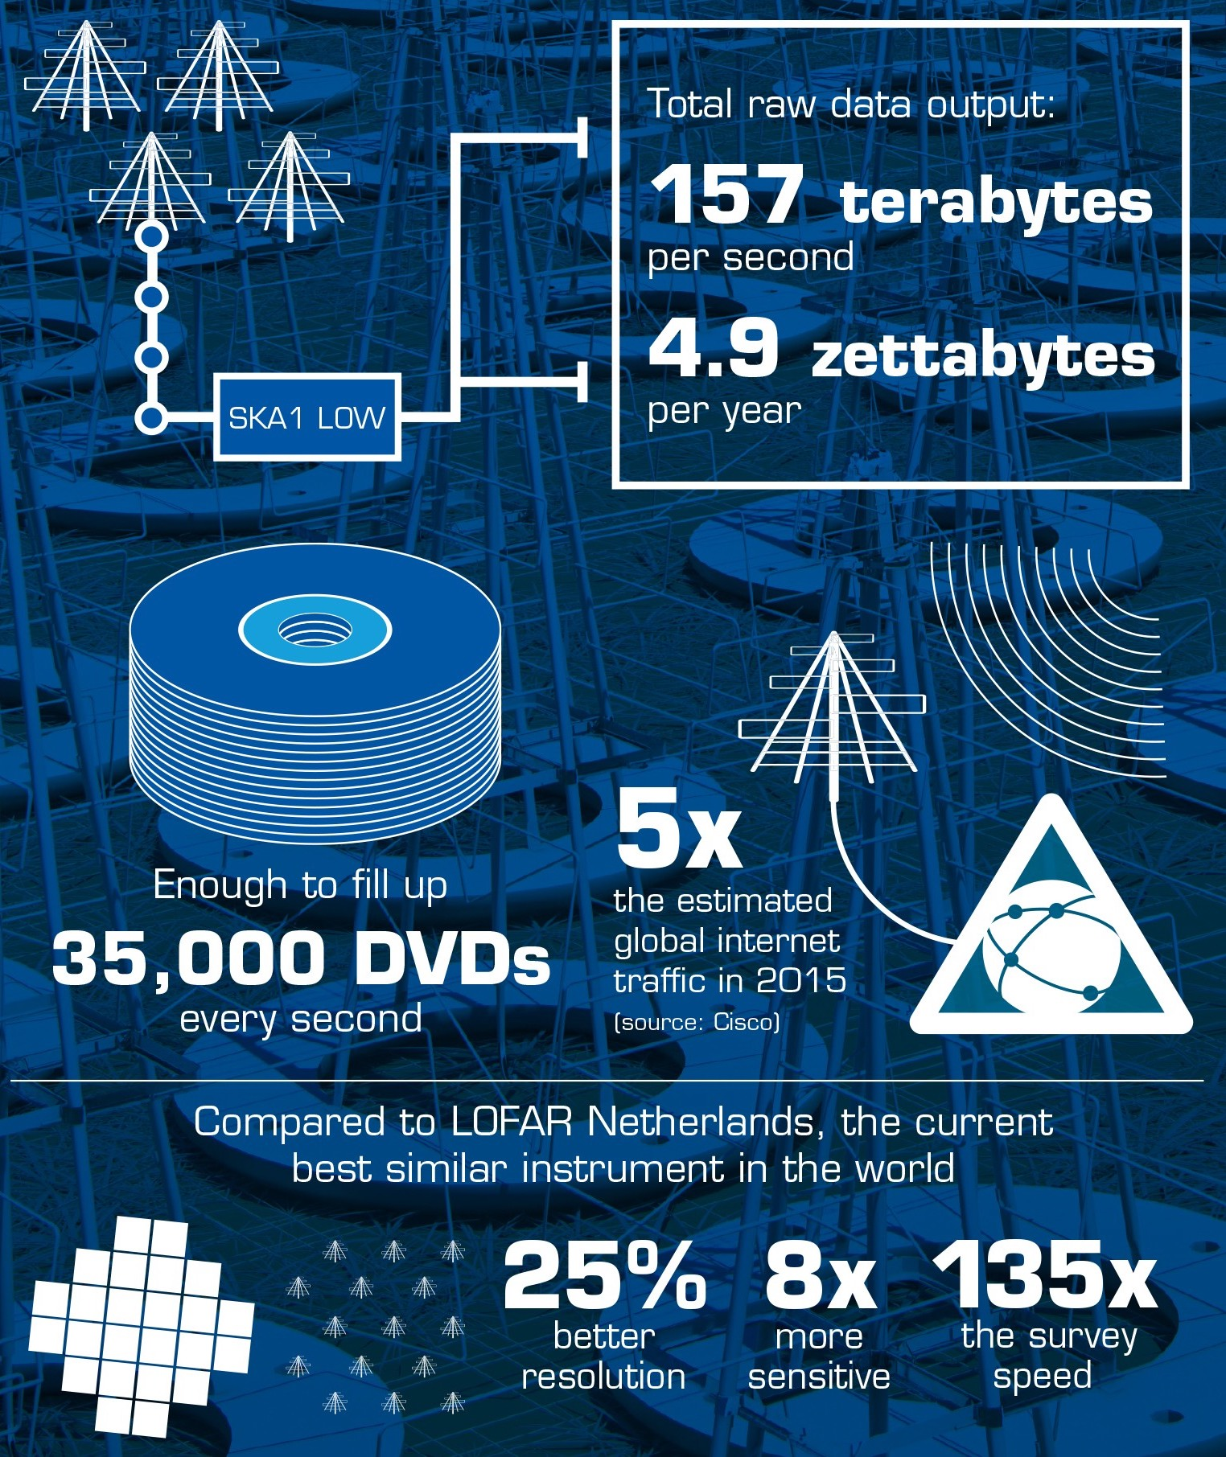
The Square Kilometre Array (SKA) challenge
SKA requirements per Science Data Processor (SDP):
~260 PFLOP/s
~157 TB/s
~5 MW
S. Corda et al., “Reduced-precision acceleration of radio-astronomical imaging on reconfigurable hardware”, IEEE Access 2022
A. Cavelan et al., “A smoothed particle hydrodynamics mini-app for exascale,” PASC 2020

Slide 4
Related work
Hardware power meters remain the most accurate method to monitor the power consumption of current computing systems.
Built-in sensors can be used for quick and reliable estimates.
Prior work:
PowerSensor2
LIKWID
PAPI
SW libraries based on NVML
J. W. Romein et al., “PowerSensor2: A Fast Power Measurement Tool”, ISPASS 2018
J. Treibig et al., “Likwid: A lightweight performance-oriented tool suite for x86 multicore environments”, ICPPW 2010
H. Jagode et al., “Papi software-defined events for in-depth performance analysis”, International Journal of HPC Applications 2019
M. Chadha et al., “Unified power and en- ergy measurement api for hpc co-processors”, IPCCC 2016

Slide 5
PMT: Power Measurement Toolkit
GOAL: provide a high-level library for power measurement in C++ and Python, not limited to HPC.
PMT:
PMT (background thread) interfaces with several power measurement back ends: NVIDIA NVML, AMD ROCM, RAPL, PowerSensor2, Xilinx Alveo, NVIDIA Jetson …
PMT is a C++ library. We provide Python bindings and Python decorators to enable power measurement in Python-user contexts.
Two modes: 1) measurement; 2) dump.
Who would use PMT?
HPC application developers (C++) to monitor and evaluate energy efficiency of their code.
Python developers that would like to measure the power consumption of their application with a simple tool.
Open source: https://git.astron.nl/RD/pmt/

Slide 6
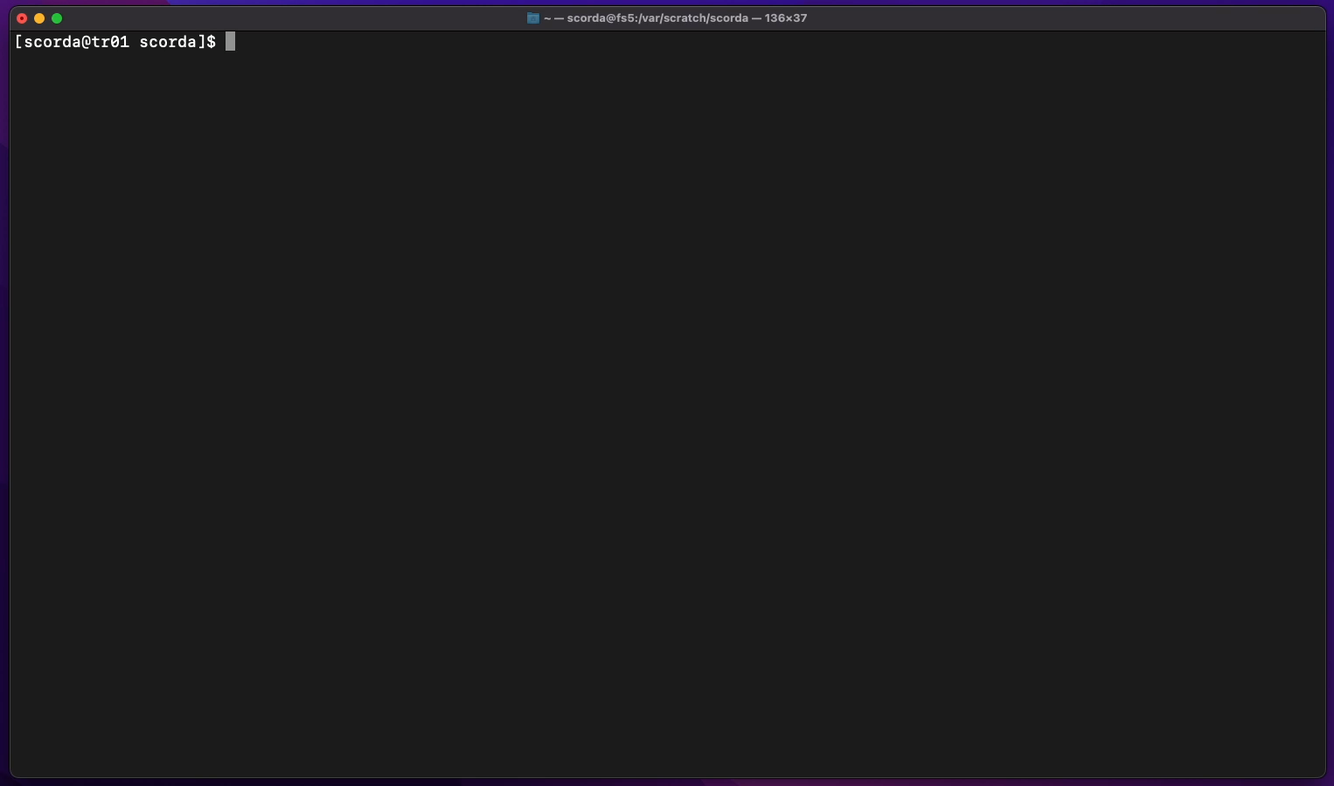
CMake installation

Slide 7
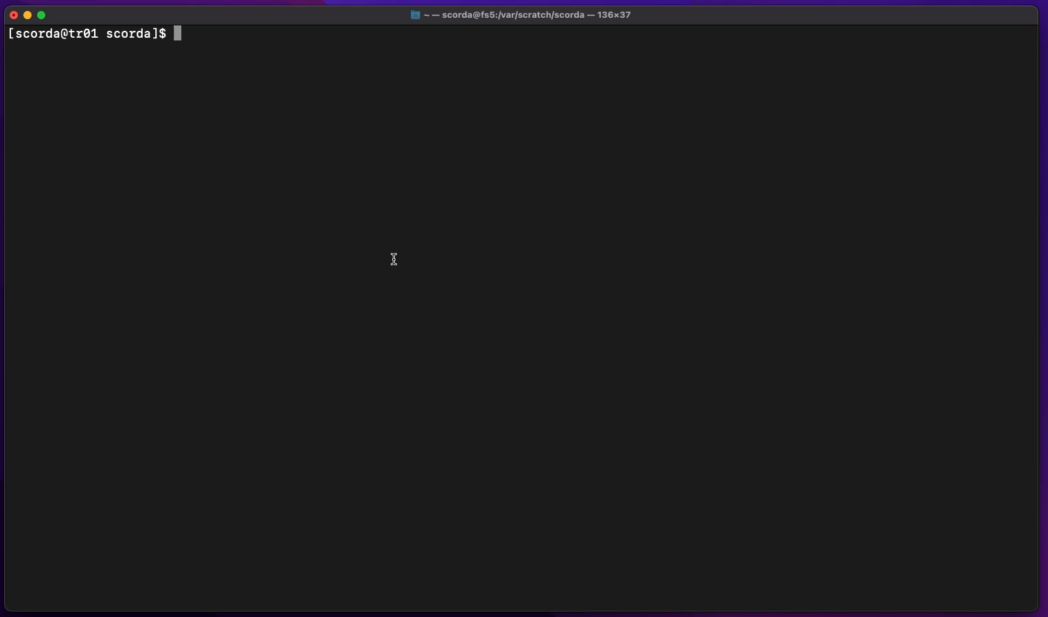
Spack installation
https://github.com/spack/spack
https://git.astron.nl/RD/schaap-spack

Slide 8
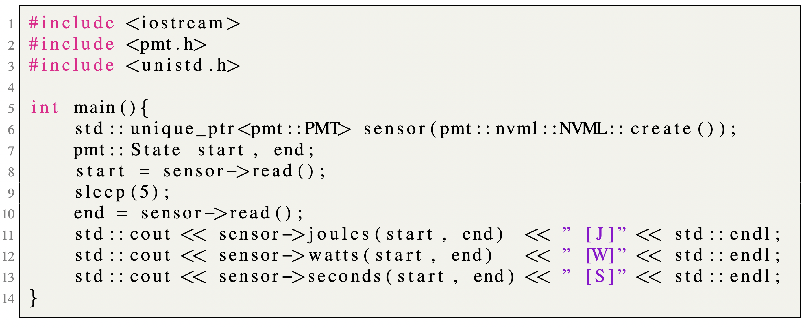
Embed PMT into C++ code

Slide 9
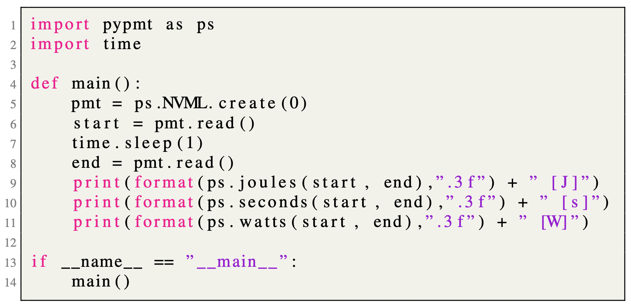
Embed PMT into Python code

Slide 10
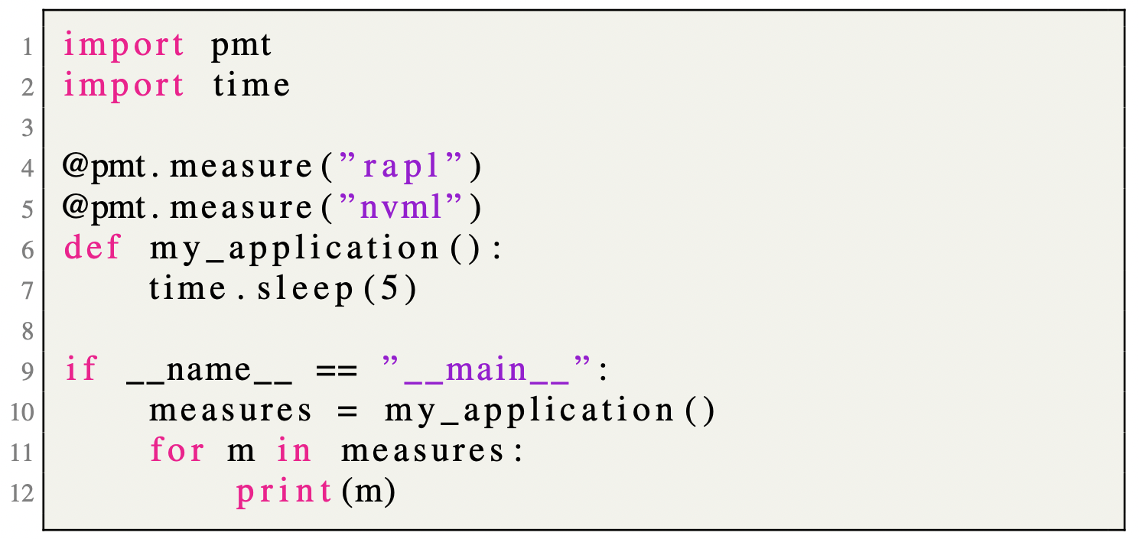
Python decorators

Slide 11
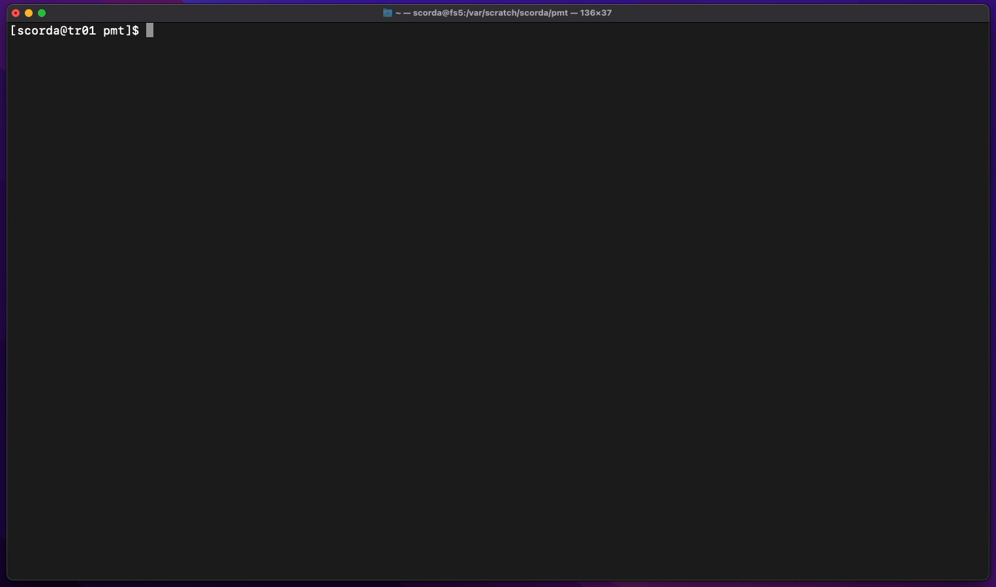
PMT (SW) power-readers

Slide 12
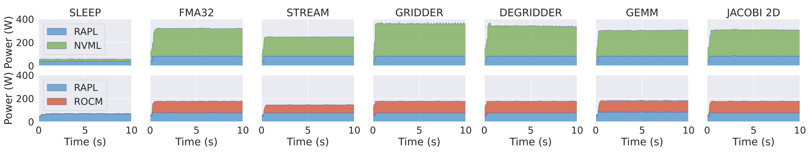
Benchmarking
Systems:
AMD Threadripper 3970x + NVIDIA RTX Titan
AMD Threadripper 3970x + AMD W6600
Benchmarks:
Microbenchmarking: SLEEP (no computation), FMA32 (many FMAs), STREAM (bandwidth test)
Radio-astronomical imaging motifs: GRIDDER and DEGRIDDER
Linear-algebra (Polybench): GEMM and JACOBI 2D

Slide 13
Conclusion and future work
Summary:
PMT: a high-level library for power consumption measurements and monitoring with a simple interface on various hardware.
PMT is an open-source library.
PMT is currently employed in radio-astronomical imaging production code for LOFAR, e.g. IDG (https://gitlab.com/astron-idg/idg).
Future work:
PMT will be used for power consumption monitoring in the context of SW/HW HPC co-design activities for the Square Kilometre Array (SKA).
PMT support for new back ends, e.g. Intel GPUs (Ponte Vecchio).

Slide 14
Acknowledgments
Anonymous reviewers of SC22 for their feedback and comments.
This work was partially funded by the Swiss State Secretariat for Education, Research and Innovation (SERI).
J. W. Romein (ASTRON) for its PowerSensor2 work, which lays the foundation of PMT.

Slide 15
PMT: Power Measurement Toolkit
Thanks!
Stefano Corda, Bram Veenboer, Emma Tolley

